Slide 1
The American Rescue Plan Act

Slide 2
Roadmap
Part 1: GFOA Guiding Principles
Part 2: Rules and Updates
Part 3: Compliance and Reporting

Slide 3
The American Rescue Plan Act of 2021

Slide 4
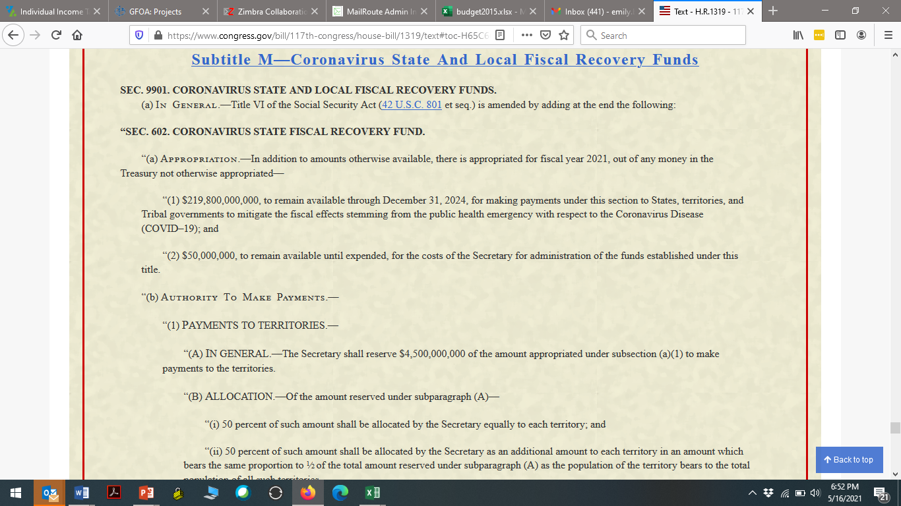
American Rescue Plan Act of 2021
American Rescue Plan Act
  Subtitle M
  Coronavirus State and Local Fiscal Recovery Funds (CSLFRF)
    Section 602: Coronavirus State Fiscal Recovery Fund
    Section 603: Local Fiscal Recovery Fund

Slide 5

Distribution Formula
The local portion of the funding is $130 billion
  Equally divided between cities and counties.
  For cities, $45.5 billion of the $65 billion will be allocated to metro cities (pop. over 50,000) utilizing a modified formula,
    and the remaining amount for smaller jurisdictions (pop. under 50,000) will be allocated according to pop. share but will not exceed 75 percent of their most recent budget.
  For counties, the $65 billion will be allocated based on the county share of population. Counties that are CDBG recipients would receive the larger share between the population based on CDBG formula.
Payments to local governments will be made in two tranches - first half 60 days after enactment, second half one year later.

Slide 6
American Rescue Plan Act of 2021
Eligible uses include (section 602 and 603)
  “(A) to respond to the public health emergency with respect to the Coronavirus Disease 2019 (COVID–19) or its negative economic impacts, including assistance to households, small businesses, and nonprofits, or aid to impacted industries such as tourism, travel, and hospitality;
  “(B) to respond to workers performing essential work during the COVID–19 public health emergency by providing premium pay to eligible workers of the State, territory, or Tribal / local government that are performing such essential work, or by providing grants to eligible employers that have eligible workers who perform essential work;
  “(C) for the provision of government services to the extent of the reduction in revenue of such State, territory, or Tribal / local government due to the COVID–19 public health emergency relative to revenues collected in the most recent full fiscal year of the State, territory, or Tribal government prior to the emergency; or
  “(D) to make necessary investments in water, sewer, or broadband infrastructure.

Slide 7
GFOA Guiding Principles

Slide 8
GFOA ARPA Guiding Principles
Temporary Nature of ARPA Funds
  Care should be taken to avoid creating new programs or add-ons to existing programs that require an ongoing financial commitment.
  Use of ARPA funds to cover operating deficits caused by COVID-19 should be considered temporary and additional budget restraint may be necessary to achieve/maintain structural balance in future budgets.
  Investment in critical infrastructure is particularly well suited use of ARPA funds because it is a non-recurring expenditure that can be targeted to strategically important long- term assets that provide benefits over many years. However, care should be taken to assess any on-going operating costs that may be associated with the project.

Slide 9
GFOA ARPA Guiding Principles
ARPA Scanning and Partnering Efforts
  Local jurisdictions should be cognizant of state-level ARPA efforts, especially regarding infrastructure, potential enhancements of state funding resources, and existing or new state law requirements.
  Consider regional initiatives, including partnering with other ARPA recipients. It is possible there are many beneficiaries of ARPA funding within your community, such as schools, transportation agencies and local economic development authorities. Be sure to understand what they are planning and augment their efforts or create cooperative spending plans to enhance the structural financial condition of your community.

Slide 10
GFOA ARPA Guiding Principles
Take Time and Careful Consideration
  Use other dedicated grants and programs first whenever possible and save ARPA funds for priorities not eligible for other federal and state assistance programs.
  Whenever possible, expenditures related to the ARPA funding should be spread over the qualifying period (through December 31, 2024) to enhance budgetary and financial stability.
  Adequate time should be taken to carefully consider all alternatives for the prudent use of ARPA funding prior to committing the resources to ensure the best use of the temporary funding.

Slide 11
Guidance and Central Statements

Slide 12
Your New Best Friends
The Interim Final Rule
Frequently Asked Questions
Compliance and Reporting Guide
The User Guide for Treasury’s Portal
2CFR200 and all Compliance Supplements
GFOA

Slide 13
Central Statements
RESTRICTIONS:
  Depositing funds into a pension fund.
  Offsetting a reduction in net tax revenue caused by the recipient’s change in law, regulation, or administrative interpretation (States/Territories only).
  Generally, using funds as non-Federal match for other Federal Programs.
  Generally, recipients may not use funds directly to service debt, satisfy a judgment or settlement, or contribute to a “rainy day” fund.
Covered period: March 3, 2021 - December 31, 2024
  Unless otherwise noted (e.g. premium pay)
Costs can be incurred by December 31, 2024
  Must be expended by December 31, 2026
“Incurred” has the same meaning given to “financial obligation” in 2 CFR § 200.1
  Financial Obligation: “An order placed for property and services and entering into contracts, subawards, and similar transactions that require payment”.
    Definition does not qualify in GAAP

Slide 14
Other Circumstances
Public Health/Negative Economic Impact:
  Beneficiaries may have incurred arrearages prior to the covered period, as long as the expenditure of the prime recipient was in the covered period.
Premium Pay:
  May be used for a period prior to the covered period, but the expenditure of the prime recipient has to be within the covered period.
Eligible Projects:
  Recipients may use funds to cover costs incurred for eligible projects planned or started prior to March 3, 2021 provided that the project costs covered by the funds were incurred after March 3, 2021.

Slide 15
Recipients & Sub-recipients
Recipients: Eligible entities identified in sections 602 and 603 that received a CSLFRF award:
  States and the District of Columbia, Territories, Tribal governments, Counties, Metropolitan cities, Non-entitlement units, or smaller local governments.
Sub-recipients: Entities that receive a sub-award from a recipient to carry out the purposes (program/project) of the award on behalf of the recipient.
Recipients are responsible for sub-recipient monitoring:
  Clearly identify to the sub-recipient that the award is CSLFRF.
  Identify all compliance requirements and any reporting requirements.
  Initial and ongoing evaluation of each sub-recipients risk of noncompliance.
  Develop written policies and procedures for sub-recipient monitoring and risk evaluation as well as sufficient document retention policies.

Slide 16
Uniform Administrative Requirements
Review:
  Applicable Uniform Guidance (Link to Electronic Code of Federal Regulations),
  2021 OMB Compliance Supplement
  Compliance Supplement Addendum (expected issuance in Fall 2021)
Make a plan:
  Per 2 CFR 200.303, your organization must develop and implement effective internal controls to ensure that funding decisions under the CSLFRF constitute eligible use of the funds and document determinations.
  Pay particular attention to processes determining eligibility and period of performance.
Notes:
Allowable activities need to be based on Treasury’s rules (currently, interim final, ultimately a final will be issued) document which specific provisions were relied on based on available guidance in IFR and FAQs.

Slide 17
WHEN WILL WE SEE THE FINAL RULE

Slide 18
Eligible Expenditures

Slide 19
Eligible Expenditures: Four Main Categories
COVID-19 or a negative economic impact
Premium pay for eligible workers
For government services to the extent of the loss of revenue
Investments in water, sewer and broadband infrastructure
Notes:
You don’t have to satisfy all four. All are mutually exclusive.

Slide 20
COVID-19 or a Negative Economic Impact

Slide 21
COVID-19 Eligible Expenditures
Eligible Uses | Details
Containing/Mitigating Covid-19 (IFR p. 16) | Vaccine programs, PPE, medical expenses Enhancing public health data systems Capital investments in public facilities to meet pandemic operational needs etc.
Behavioral Healthcare Needs (IFR p. 17) | Mental health/substance abuse treatment Crisis intervention/hotlines Services to promote access to social services
Payroll/Benefits for: Public health/safety Human services Similar employees (IFR p. 18) | Eligible to the extent that the work completed was for COVID-19 response/mitigation. For administrative convenience, public health/safety workers, recipients can use funds to cover the full payroll and covered benefits costs for employees or operating units or divisions primarily dedicated to the COVID-19 response. Payroll and covered benefits can also be used for an employee’s pension benefits as part of their payroll contribution to their pensions (FAQs).

Slide 22
Negative Economic Impact
Eligible Uses | Details (p. 21-38)
Impacted Industries (Tourism/Travel/Hospitality etc.) (IFR p. 32) | Implement COVID-19 mitigation/prevention measures to enable safe resumption of tourism, travel, and hospitality services E.g. improvements to ventilation, physical barriers or partitions, signage to facilitate social distancing, provision of masks or personal protective equipment, or consultation with infection prevention professionals to develop safe reopening plans
Rebuilding Public Sector Capacity to Pre-Pandemic Levels (IFR p. 32) | Payroll Benefits Rehiring public-sector staff Replenishing UI trust funds
Small Business support (IFR p. 30) | Loans, grants, in-kind assistance for operation continuity, mitigation/prevention, and counseling programs to rebound from the downturn
Hardest-hit Communities (IFR p. 34) | Investing in socioeconomic disparities, housing/communities Addressing disparities in education

Slide 23
UPDATES
Retroactive payments to individuals in utility, rental arrearages
Public health and safety payroll covered – defined “primary dedication”
Capital investments in public facilities to meet pandemic operational needs includes retrofitting public facilities for the purpose of COVID-19
“Hardest Hit Communities” Better defined in the Compliance and Reporting document
Tax treatments of payments to individuals in IRS

Slide 24
IRS Engagement
CRA Taxable Income
Grants to businesses are considered gross taxable income
Loan programs proceeds are generally not included in gross income unless the amount of that loan is forgiven
ERAP
A renter receiving relief is not considered income to households
ARPA
To individuals?
ERA payments, including utilities or energy expenses are not considered income
Payments to landlords IS taxable
Payments directly to a distributing entity is taxable
To businesses?
To distributing entitles?

Slide 25
B. Premium Pay for Eligible Workers

Slide 26
Premium Pay (IFR p. 40)
Can be used retroactively
Employees of the jurisdiction designated by executive as essential
Can be provided directly, or through grants to private employers to public health/safety staff and essential workers outside the public sector:
Workers at food production facilities, grocery stores, and restaurants, janitors/sanitation workers, truck drivers, and warehouse workers etc.
  Contact workers performing essential work also eligible.
    E.g. If a municipality contracts with a third party to perform sanitation work, the third-party contractor could be eligible to receive a grant to provide premium pay for these eligible workers.

Slide 27
UPDATES
Questions still outstanding:
  Justification of 150% of “average wage”
  Tax responsibility of income to non-governmental workers
Semantics: NOT “bonus” or any supplant of pay

Slide 28
C. For Government Services to the Extent of the Loss of Revenue

Slide 29
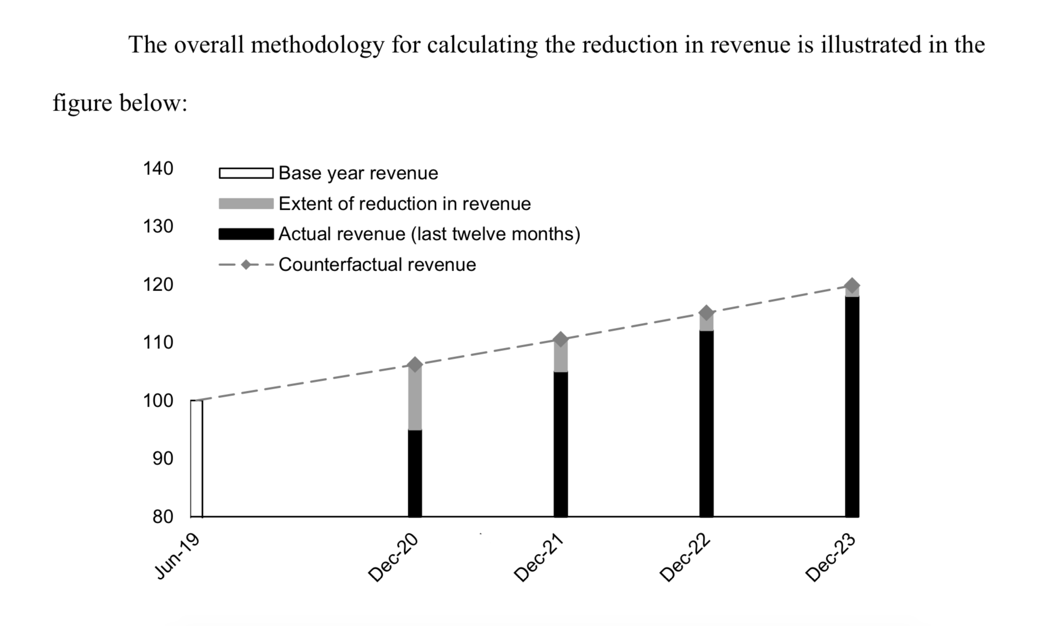
Types of Data Needed (IFR p. 53)

Slide 30
Revenue Calculation
What is OUT of the revenue calculation:
  Federal transfers (even those flowing through the State) (IFR)
  Intergovernmental transfers from your entity to your entity (Census p. 45)
  Revenues from utilities (water supply, electric power, gas supply, and public mass transit systems) Census p. 65
  Refunds and other correcting transactions (IFR)
  Proceeds from the issuance of debt (IFR)
What is IN?
  Everything not listed above
    taxes, fees and other revenues to support public services
  Including Fees generated by the underlying economy
    Component units and enterprise funds
    civic center, zoo, parking, ports, sports stadiums etc. etc. etc.

Slide 31
GFOA Revenue calculator

Slide 32
Base year calculation includes:
  Taxes
  Intergovernmental revenue
  Other revenues
Growth rate:
  Compares years 2016-2019 in eligible revenue categories
Actual revenues calculated on December 31 each year

Slide 33
Process for Revenue Replacement
Look at the past 2019 base year revenue
Recipients average annual growth of the past three fiscal years
  Apply 4.1% growth rate or greater to annual revenues collected
Multiplier applies to the revenue collected in each calendar year
  Checkpoint each December 31 for actual revenues
  Not the fiscal year!
Compare projected growth revenue to actuals collected
  If actual exceeds projected, collection is zero for that year

Slide 34
Government Services
What can I spend it on?
  “Government services”
    Directly provide services or aid to citizens
    Maintenance pay go of building
      Can use it on a capital project together with bond financed portion
      You can start a project and you finish it with future revenues / bonds
    Cybersecurity, Healthcare service, School or education services, Police, fire or public safety
  NOT ALLOWED:
    NOT ON principal or interest of debt service (or settlement agreement)
    NOT ON reserves or rainy day funds

Slide 35
UPDATES
No definitive word about fiscal year end versus calendar year end HOWEVER:
  Treasury consistently says to follow the Interim Final Rule
  Interim Final Rule says prime recipients must use consistent accounting methodologies
  Compliance and Reporting requires prime recipients to report December 31 figures no later than 31 days after year end
Local procurement policies (including collaborative purchasing programs) in lieu of competitive purchasing requirements. Treasury notes addressing this in final rule

Slide 36
D. Investments in Water, Sewer and Broadband Infrastructure

Slide 37
Water/Sewer Infrastructure
Necessary investments are designed to provide an adequate minimum level of service and are unlikely to be made using private sources of funds.
Uses aligned with Environmental Protection Agency’s Clean Water Revolving Fund and Drinking Water State Revolving Fund to expedite project identification.
  Building/upgrading facilities and transmission, distribution, and storage systems, including the replacement of lead service lines.
  Invest in wastewater infrastructure projects
    E.g. constructing publicly-owned treatment infrastructure, managing and treating stormwater or subsurface drainage water, facilitating water reuse, and securing publicly-owned treatment works
Recipients retain substantial flexibility to identify those water and sewer infrastructure investments that are of the highest priority for their own communities

Slide 38

Broadband Infrastructure (IFR p. 61)
Build broadband infrastructure with modern technologies in mind, specifically projects that deliver services offering:
  reliable 100 Mbps download and 100 Mbps upload speeds, unless impracticable due to topography, geography, or financial cost.
Assisting households to support internet access or digital literacy is an eligible use.

Slide 39
Audit and Reporting Requirements

Slide 40
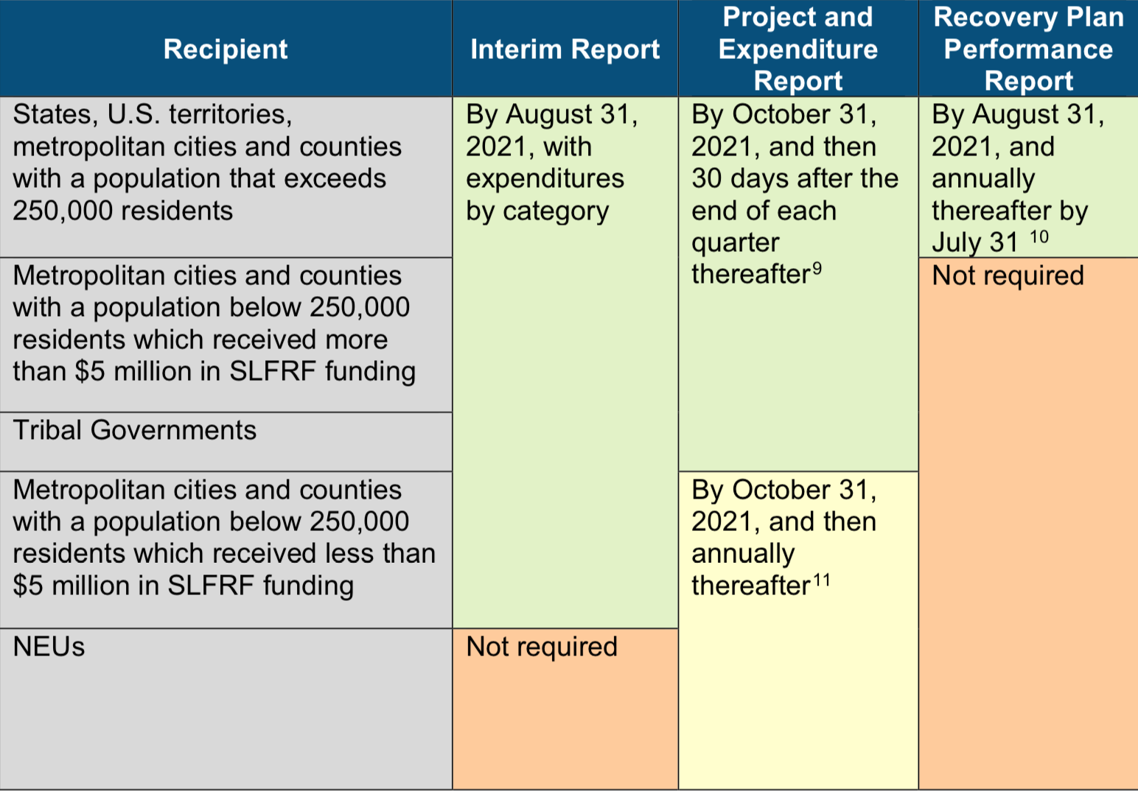
Compliance and Reporting Guidance
Deadline changed to January 31, 2022
Deadline changed to April 30, 2022

Slide 41
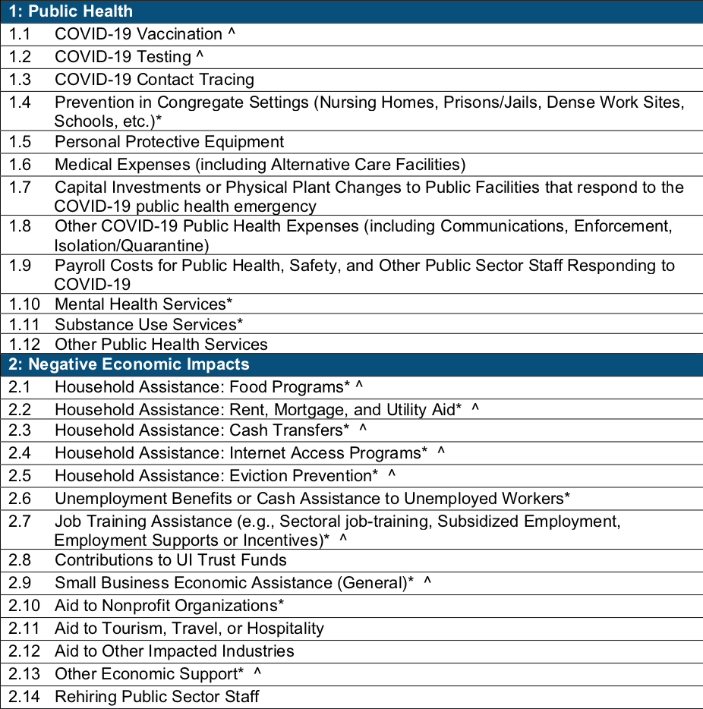
Use of Expenditure Categories (EC)
Appendix 1
  Compliance & Reporting Guidance (p. 31)
EC must be used to categorize each project.
* symbol denotes areas where recipients must identify the amount of the total funds that are allocated to evidence-based interventions.
^ symbol denotes areas where recipients must report on whether projects are primarily serving disadvantaged communities.
  Project demographic distribution

Slide 42
Use of Evidenced-Based Intervention
Compliance & Reporting Guidance Appendix 2 (p. 33)
Strong Evidence | Moderate Evidence | Preliminary Evidence
The evidence base can support causal conclusions for the specific program proposed by the applicant with the highest level of confidence. Consists of one or more well-designed and well-implemented experimental studies conducted on the proposed program with positive findings on one or more intended outcomes. | Reasonably developed evidence base that can support causal conclusions. Evidence base consists of one or more quasi-experimental studies with positive findings on one or more intended outcomes OR two or more non- experimental studies with positive findings on one or more intended outcomes. | Evidence base can support conclusions about the program’s contribution to observed outcomes. The evidence base consists of at least one non- experimental study. A study that demonstrates improvement in program beneficiaries over time on one or more intended outcomes OR an implementation (process evaluation) study used to learn and improve program operations would constitute preliminary evidence.

Slide 43
Project Demographic Distribution
Recipients will be asked to identify whether or not the project is serving an economically disadvantaged community.
Recipients may assume that the funds for a project count as being targeted towards economically disadvantaged communities if the project funds are spent on:
  A program or service is provided at a physical location in a Qualified Census Tract (for multi-site projects, if a majority of sites are within Qualified Census Tracts);
  A program or service where the primary intended beneficiaries live within a Qualified Census Tract;
  A program or service for which the eligibility criteria are such that the primary intended beneficiaries earn less than 60 percent of the median income for the relevant jurisdiction (e.g., State, county, metropolitan area, or other jurisdiction); or
  A program or service for which the eligibility criteria are such that over 25 percent of intended beneficiaries are below the federal poverty line.

Slide 44
PROJECT & EXPENDITURE REPORT
DEADLINE: January 31st and April 30th

Slide 45
Project & Expenditure Report
QUARTERLY REPORT
WHO:
  States, territories and tribal governments
  Metropolitan cities and counties that received more than $5M
WHEN:
  Initial report will cover two calendar quarters from the date of award to September 30, 2021
    DUE January 31st 2022
  Subsequent quarterly reports will cover one calendar quarter
    Must be submitted within 30 calendar days after the end of each calendar quarter.
ANNUAL REPORT
WHO:
  Metro cities and counties that received less than $5M
  NEUs
WHEN:
  Initial reports will cover the date of award to September 30, 2021
    DUE April 30th 2022
  Subsequent reports will cover one calendar year
    Must be submitted by October 31 of that year
Notes:
Federal fiscal year is Oct. 1 – Sept. 30

Slide 46
Required Information
Projects (and defining projects):
Projects are new or existing eligible government services or investments funded in whole or in part by the CSLFRF funding.
For each project, the recipient will be required to enter:
  the project name, identification number (created by the recipient), project expenditure category (see Appendix 1), description, and status of completion.
Between 50 and 250 words.
For each project, the recipient will be asked to select the appropriate EC based on the scope of the project in Appendix 1.
Projects should be scoped to align to a single EC.
Notes:
Projects should be defined to include only closely related activities directed toward a common purpose
Project descriptions must describe the project in sufficient detail to provide understanding of the major activities that will occur, and will be required to be between 50 and 250 words

Slide 47
Required Information
Expenditures
Current period obligation
Cumulative obligation
Current period expenditure
Cumulative expenditure
Project status
Not started
Completed less than 50 percent
Completed 50 percent or more
Completed

Slide 48
Required Information – Infrastructure (cont.)
Infrastructure projects (EC 5)
Each project is required to satisfy the reporting requirements listed but additional reporting includes:
  Projected/actual construction start date (month/year)
  Projected/actual initiation of operations date (month/year)
  Location (for broadband, geospatial location data)

Slide 49
Required Information – Infrastructure
Projects Over $10M
EITHER:
  Davis bacon certification OR
  Project employment and local impact report
EITHER:
  Certification that a project includes a project labor agreement OR
  Project workforce continuity plan
Whether the project prioritizes local hires
Whether the project has a Community Benefit Agreement with a description of the agreement
Additional information for water and sewer and broadband projects
Notes:
Project labor agreement a pre-hire collective bargaining agreement consistent with section 8(f) of the National Labor Relations Act (29 U.S.C. 158(f)).
Workforce continuity plan – ensure ready access to sufficient number of skilled and unskilled labor for high-quality construction, minimize risk of labor disputes and disruptions, provide safe and healthy workplace, prevailing wages and benefit for the area, whether there is a project labor agreement

Slide 50
NEU Documentation
Each NEU will also be asked to provide the following
information with their first report submitted by April 30, 2022:
  Copy of the signed award terms and conditions agreement (which was signed and submitted to the State as part of the request for funding)
  Copy of the signed assurances of compliance with Title VI of the Civil Rights Act of 1964 (which was signed and submitted to the State as part of the request for funding)
  Copy of actual budget documents validating the top-line budget total provided to the State as part of the request for funding

Slide 51
Helpful Resources
Treasury Resources:
  Treasury’s ARPA Main Website
  Request Funding
  Interim Final Rule
  FAQs (July 19, 2021)
  Non-entitlement Unit of Government Information
  Compliance and Reporting Guidance – including performance report template
GFOA Resources:
  Coronavirus Response Resource Center
  Analysis of the American Rescue Plan
  ARPA Revenue Replacement Calculator
  CSLFRF Guidance Frequently Asked Questions
  GFOA Guiding Principles

Slide 52
Thank you!

